Slide 1
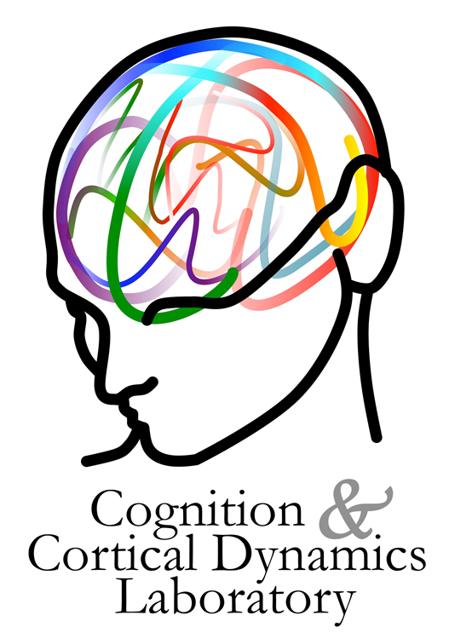



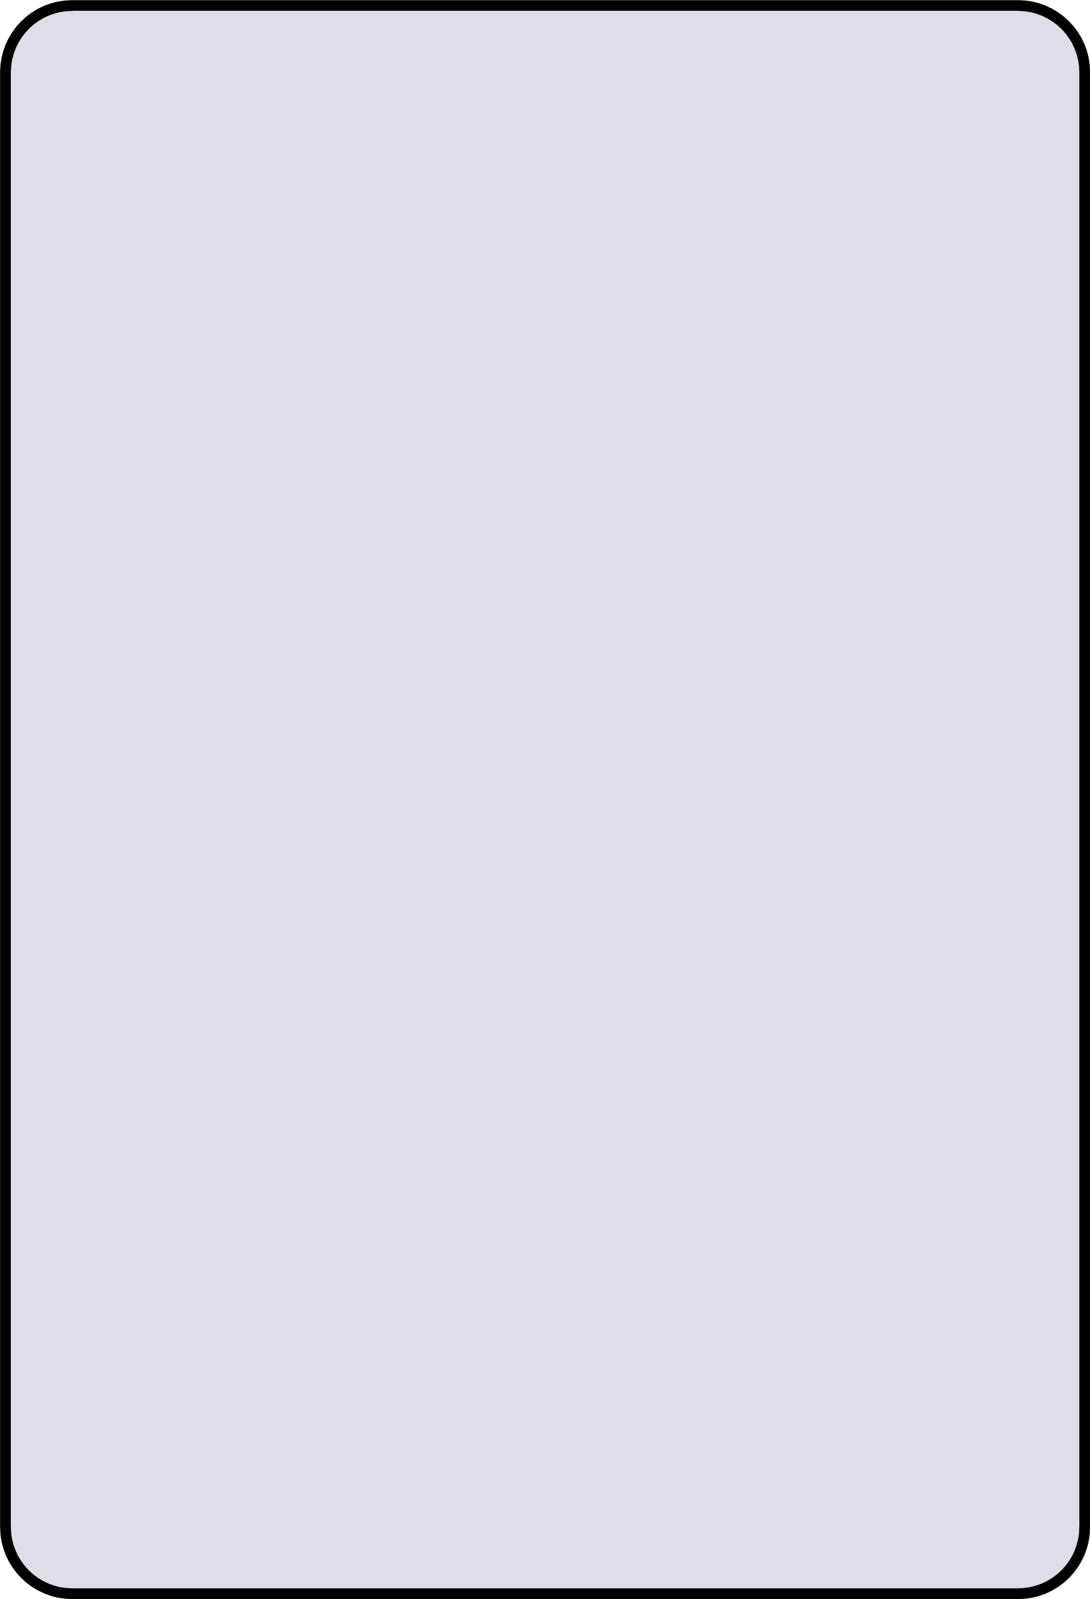
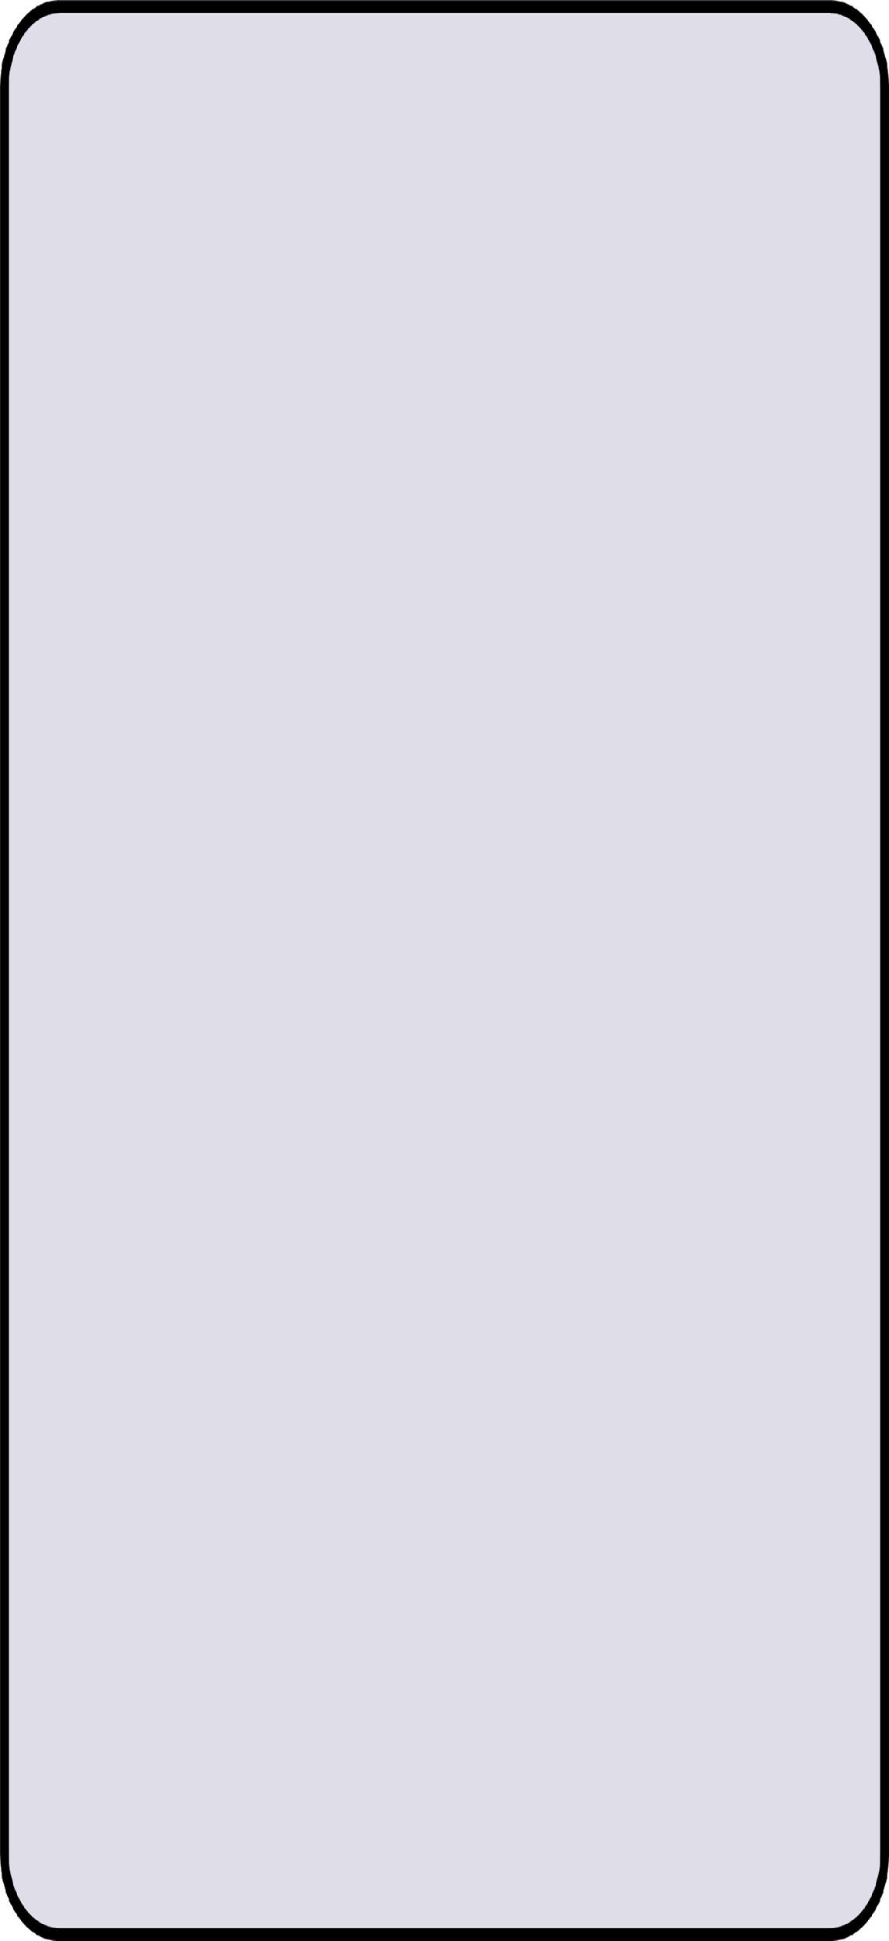

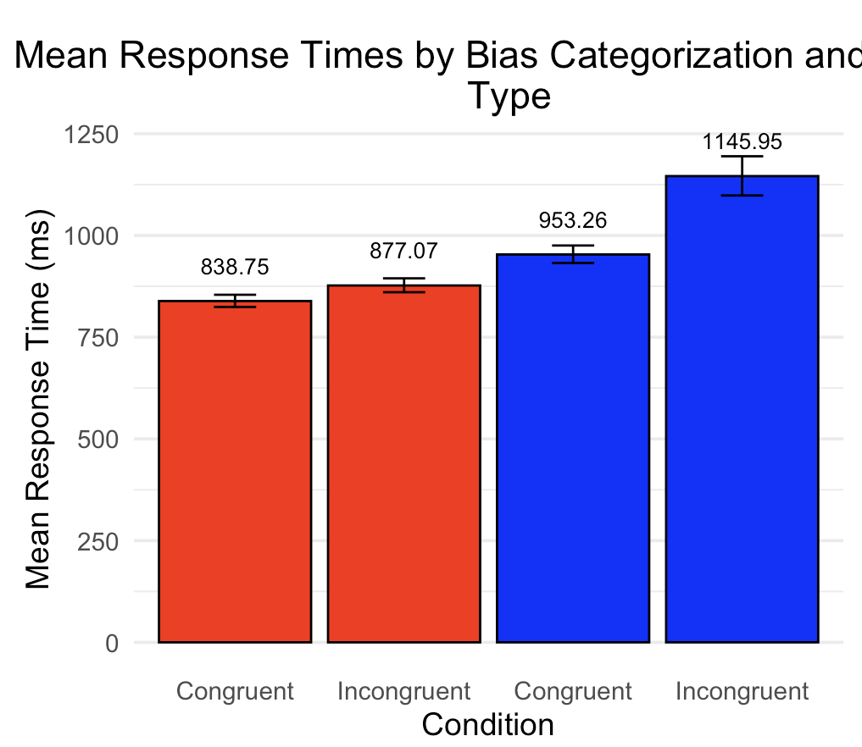

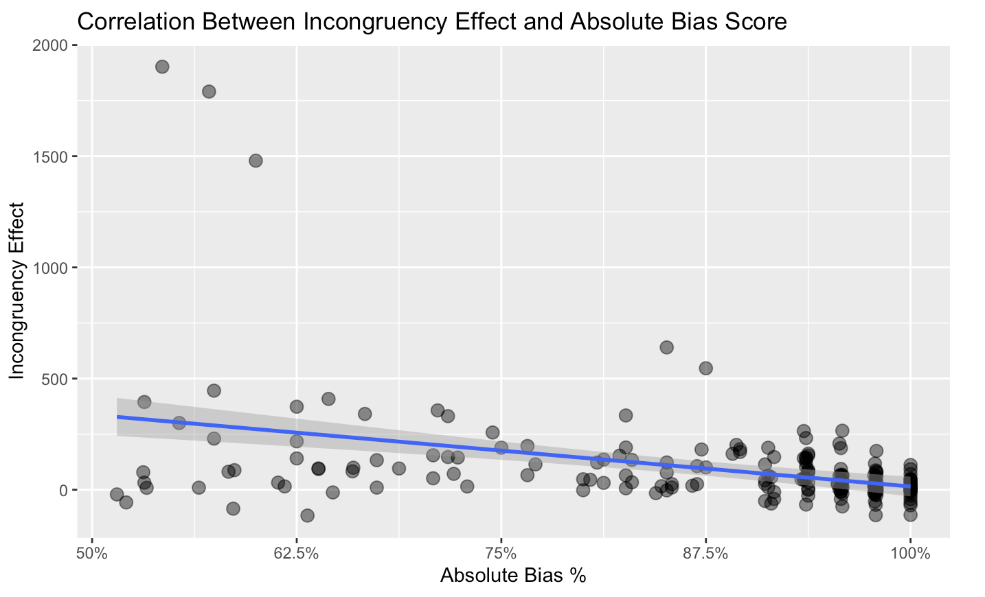
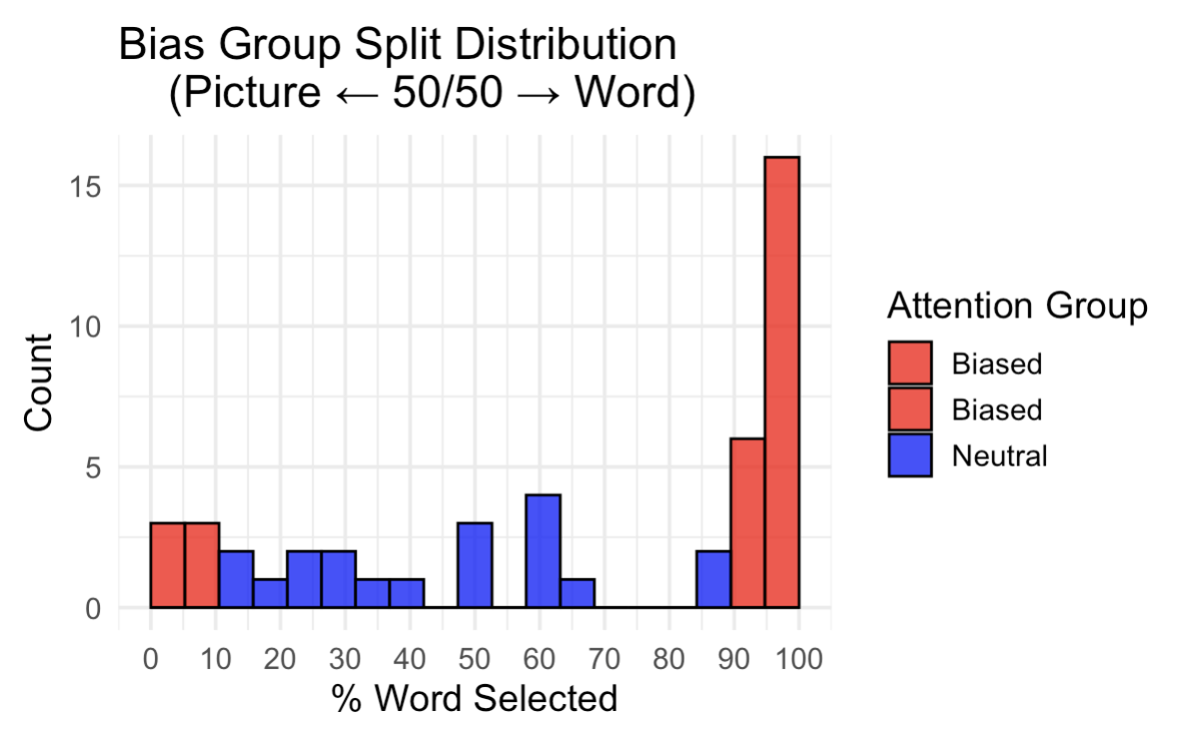
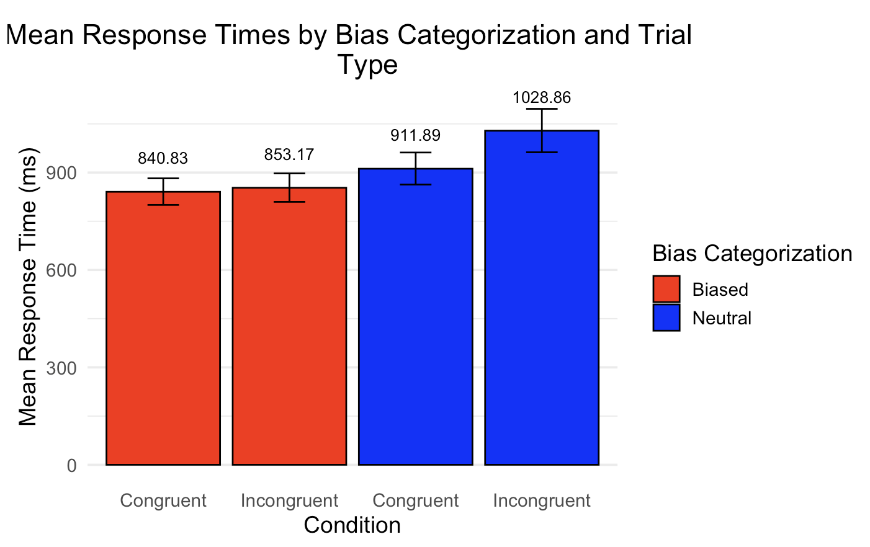

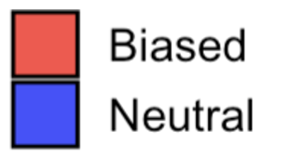

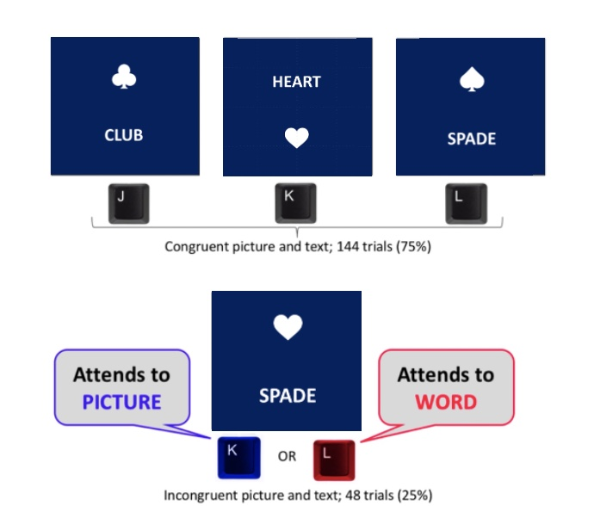
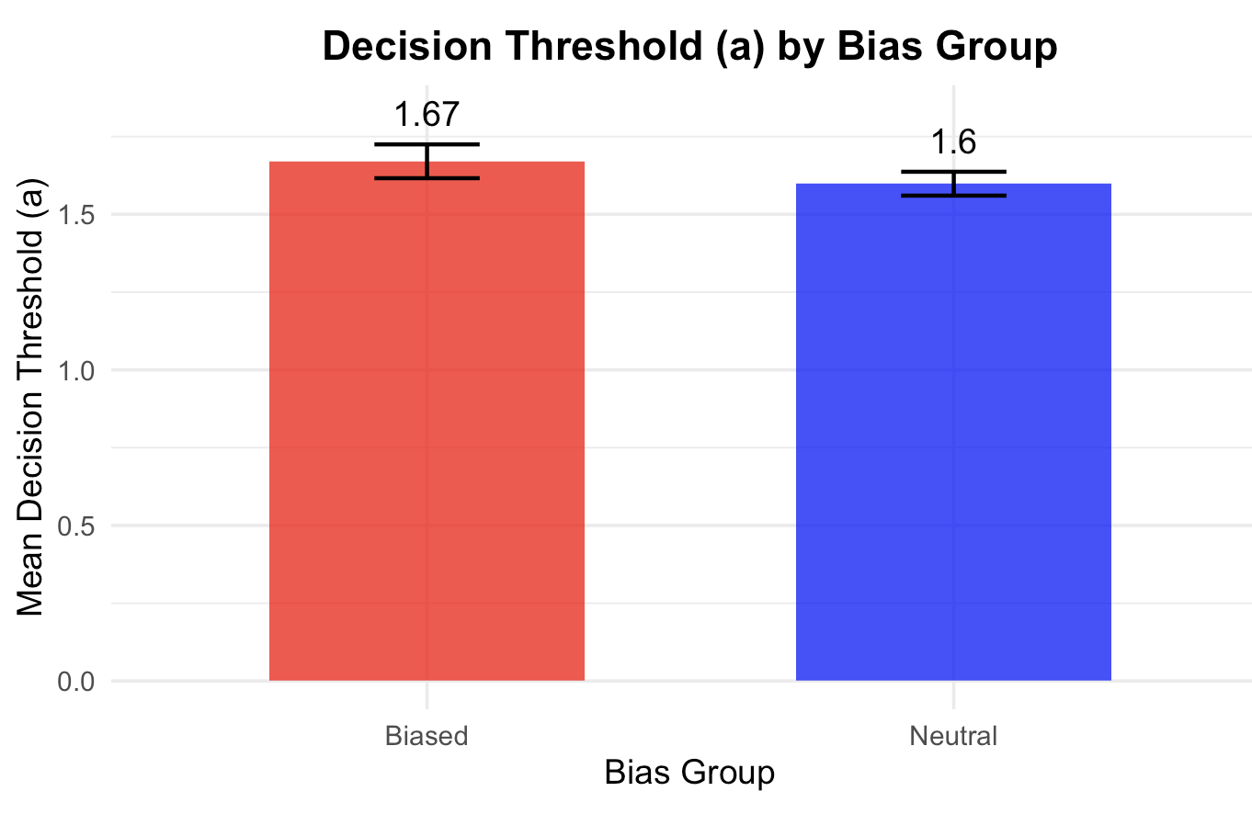
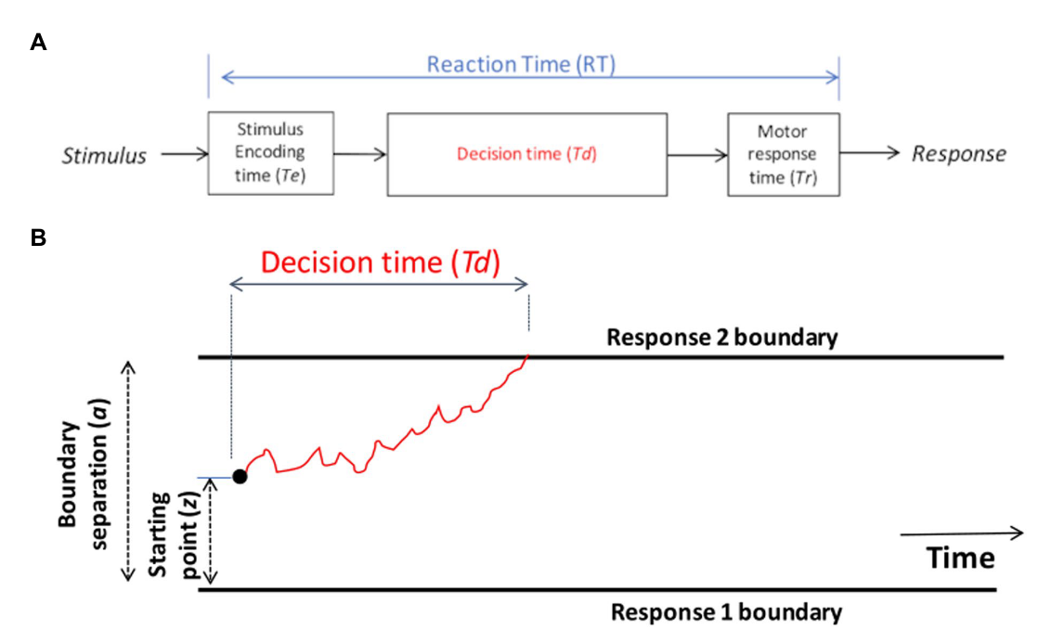
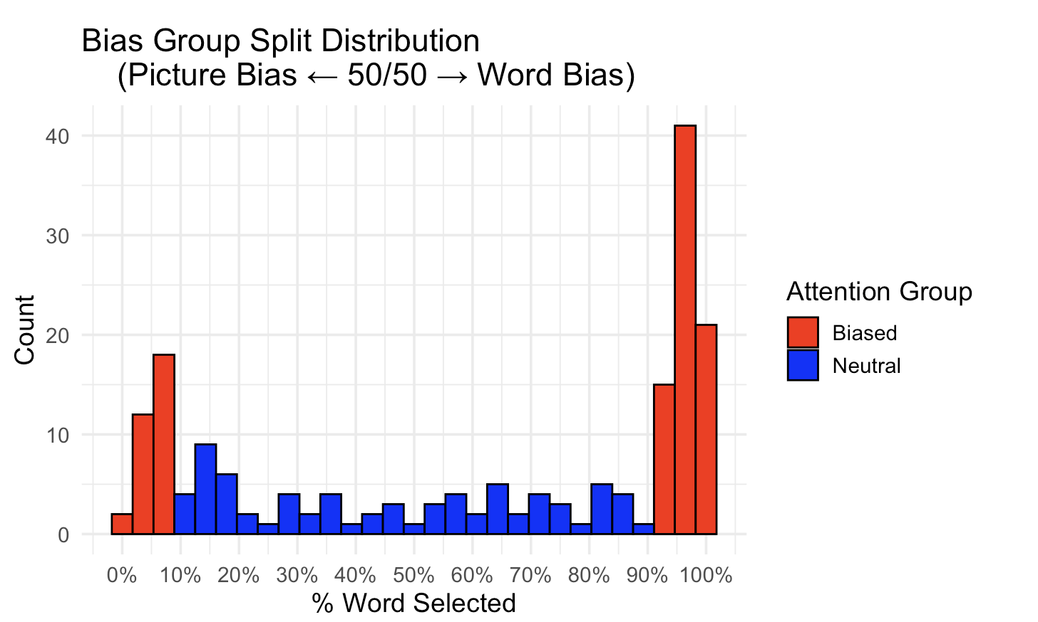
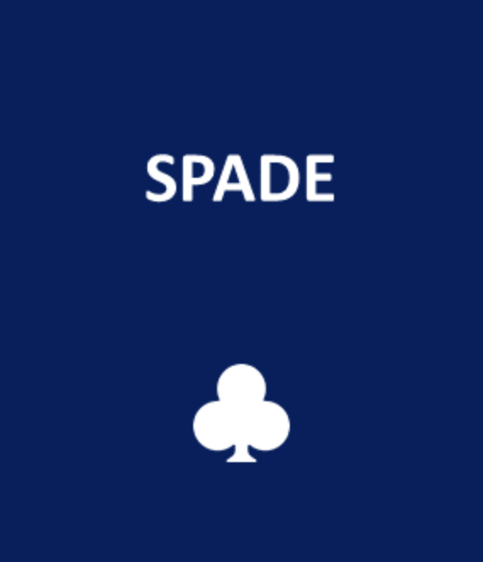
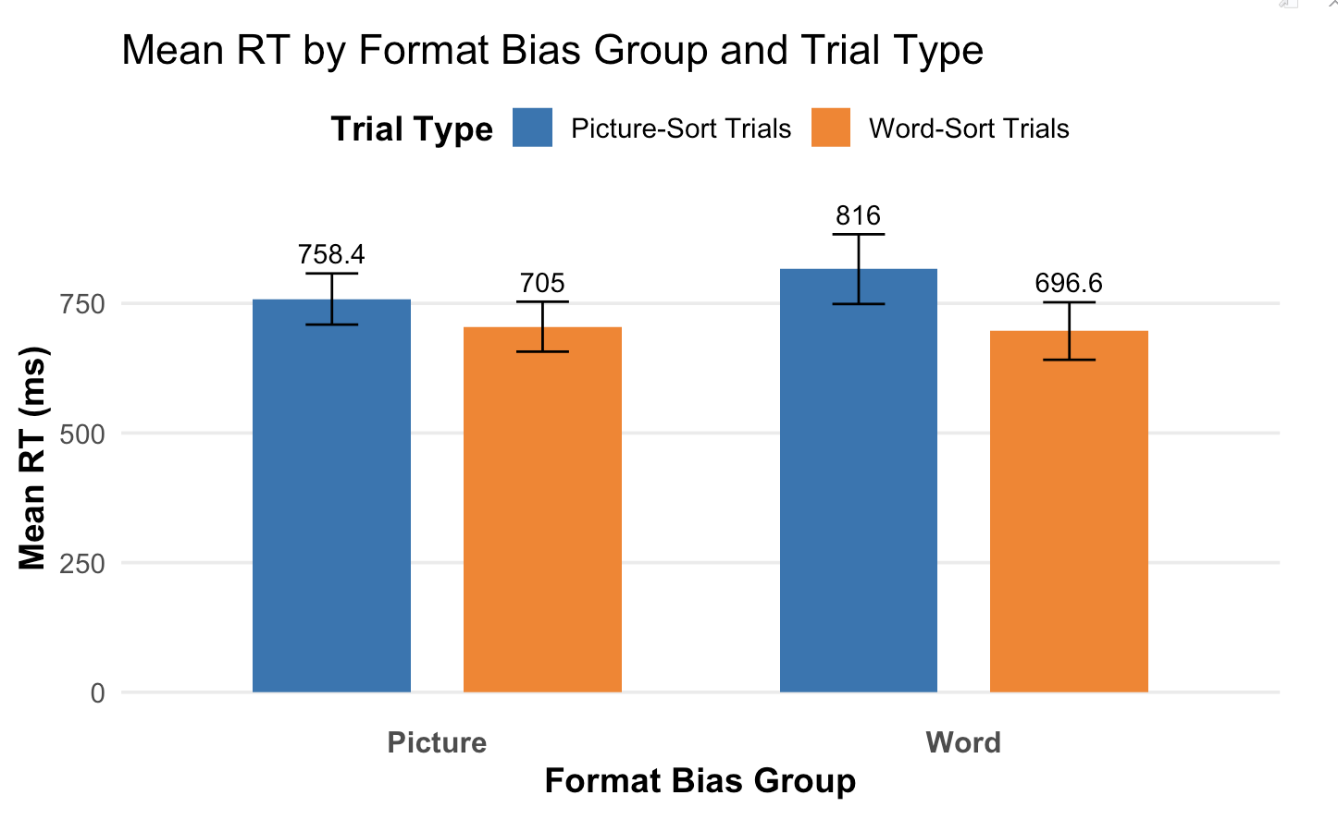
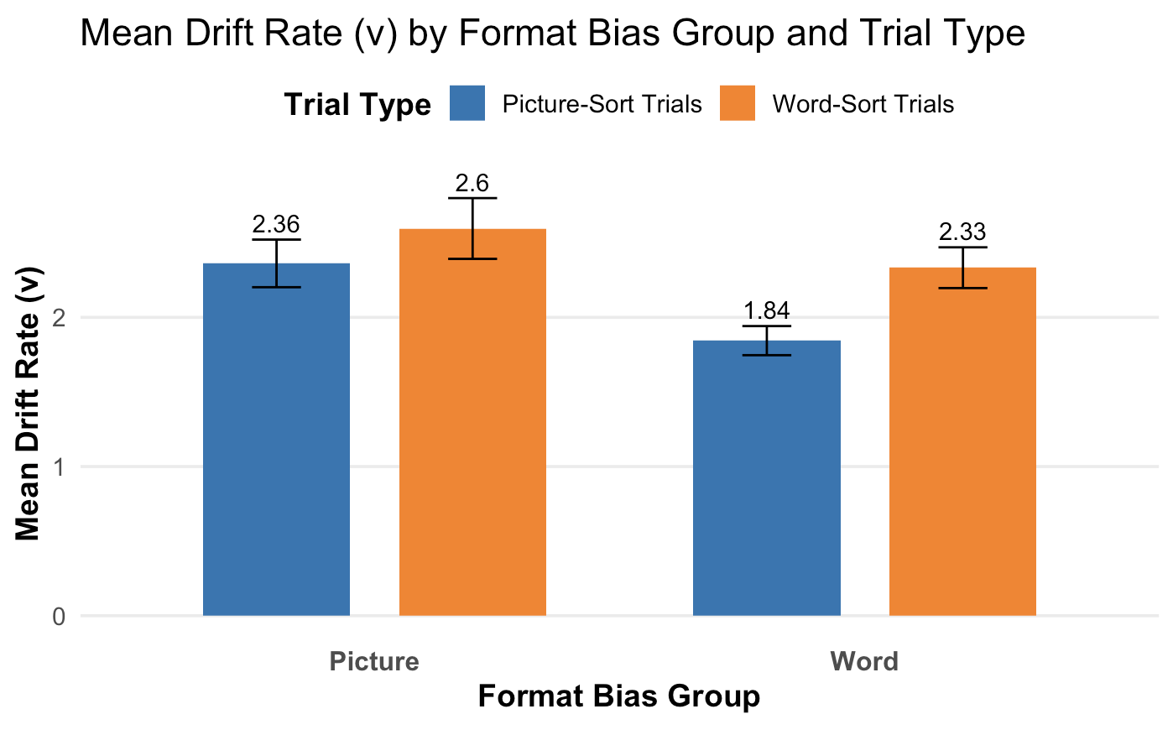
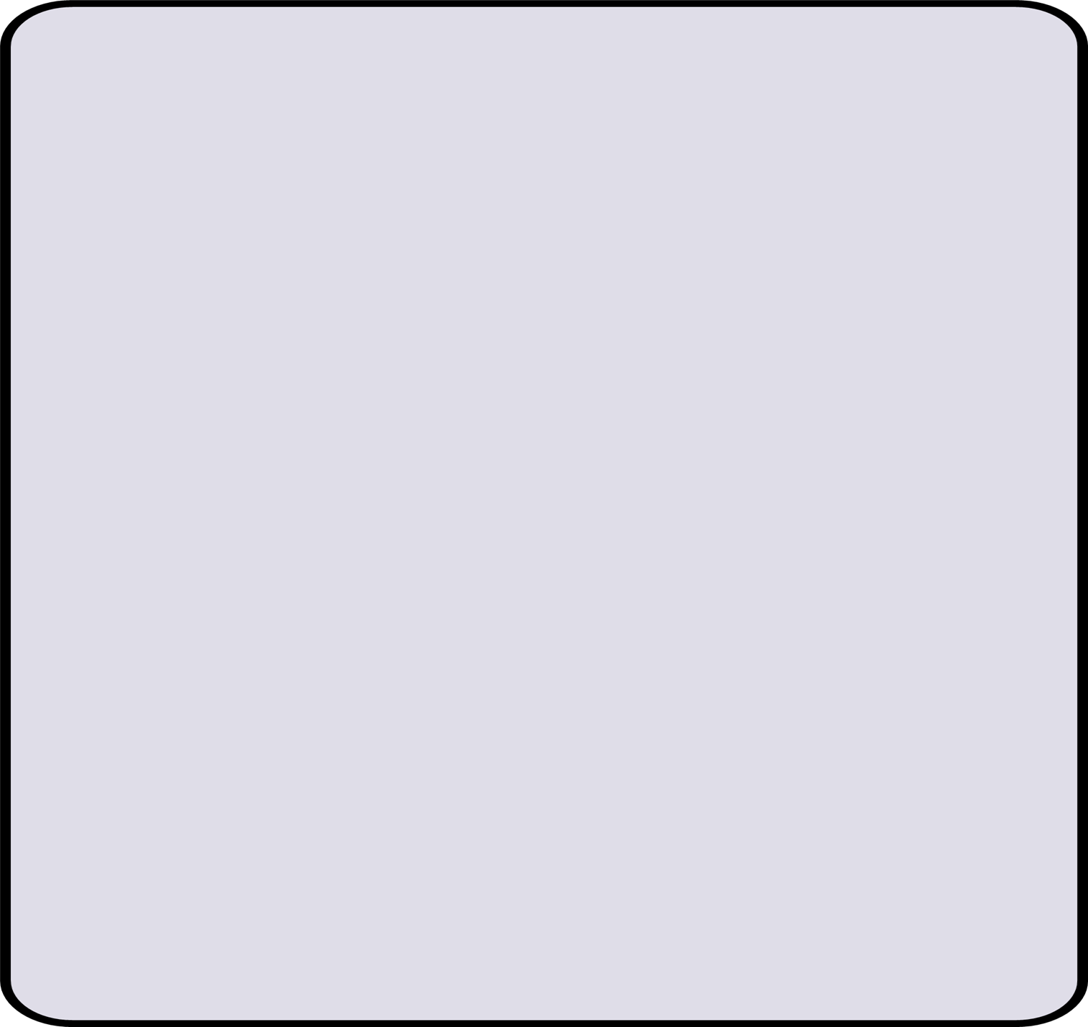


Exploring Individual Differences in
Decision Strategy
Maia Czerwonka,¹ Malayka Mottarella,² & Chantel S. Prat ¹
Department of Psychology, University of Washington
Exponent, Inc.
Introduction
Results
Results: RT Replication
Response Time ANOVA
When presented with conflicting visual and verbal information, individuals differ in the information they use to make decisions, and these differences have been related to neural organization for semantic concepts presented in either modality. ¹
In two experiments using the Card Sorting Task (CST) we examine how and why individuals make decisions when presented with conflicting information.
Word-sort blocks were faster than picture-sort blocks (Main effect of block type: F(1,26)= 55.78, p < 0.001 )
This difference was biggest in word bias group (Interaction: F(1,26)= 8.35, p = 0.007)
No differences in word biased versus picture biased (No main effect of format bias: F(1, 26)=0.023, p=0.88)
Mean Response Times by Bias Categorization and Trial Type
+
NEUTRAL
BIASED
NEUTRAL
BIASED
ROI Results
Drift Rate ANOVA
Figure 6 (Left). Shows participant distribution of picture vs. word selection during the CST.
Figure 7 (Right). Bar graph comparing biased and neutral group mean response times during congruent and incongruent trials in the CST.
Faster drift rates in word-sort blocks
(Main effect of block type: F(1,26)= 9.20, p < 0.001 )
Trend toward faster drift rates in picture bias group (Trending main effect of format bias: F(1, 26)=2.965, p=0.097)
No interaction (F(1,26)= 1.591, p = 0.218)
Figure 3 (Left). CST response times by format bias group.
Figure 4 (Right). Correlation between incongruency effect and absolute bias score.
With only two blocks of CST and fewer participants, we replicate the finding that biased responders are less sensitive to conflict (interaction: F(43) = 5.83, p = 0.02) and observe a trend toward them being faster than neutral attenders (trending main effect of group: F (43)=8.90 , p =0.072). We also observed a main effect of congruency F (43)=3.40 , p =0.005.
Congruent (75%)
Main effect of group (biased group faster overall):
F (179)= 26.27, p < 0.001
Main effect of trial type (congruent faster than incongruent): F(179) = 99.40, p < 0.001
Interaction: F (179)= 15.16, p < 0.001
Format Bias and Incongruency Effect Correlation:
r(180)=-0.38, p < 0.001
Incongruent (25%)
n.s.
Figure 1. Upper panel shows congruent trials and the keys that correspond to each suit as presented during instructions. Lower panel shows an example of an incongruent trial (adapted from 1).
Drift Diffusion Modeling (DDM)
DDM evaluates decision-making as the accumulation of evidence over time toward one of two responses, where the rate of accumulation, decision threshold, and stimulus encoding time account for variation in RT and accuracy.
Analyzed Rule-Based Card Sorting Task (RBCST) data for word and picture format sorting conditions to examine differences in evidence accumulation (“drift rate”) between picture and word format groups and for differences in decision strategies (“decision threshold”) between neural and biased groups.
Prior research using responses to conflict trials has established that individuals differ in their reliance on picture vs. word information (“format”). ¹ The degree to which the strength of that preference (“format bias”) varies across individuals remains less understood.
Discussion
As predicted, more format biased individuals showed smaller incongruency effects.
Format biased individuals were also faster overall.
Experiment 1:
Do individual differences in strength of bias influence sensitivity to conflict?
Experiment 2:
Are differences in CST decisions under conflict driven by relative skills with formats or by a more general decision strategy?
Discussion
Across both experiments, individuals differed in the information format they attended to and the strength of their decision-making bias.
More biased deciders tended to be faster and less sensitive to conflicting information.
Both word and picture biased groups responded faster to word-sort blocks. This is likely due to words being processed more readily.
Contrary to the General Decision Strategy Hypothesis, preliminary DDM results suggest that biased and neutral groups do not differ in decision threshold.
Word-biased participants were faster in word-sort blocks than in picture-sort blocks, but the reverse was not true for picture-biased participants.
These preliminary results are partially consistent with the Relative Skill Hypothesis, as ease of processing words affects drift rate overall, but does not fully account for differences in word/picture biases.
Hypothesis: Individuals who have a stronger bias toward one format will be less likely to notice conflicting information in the other format and thus slow down less in conflicting trials, resulting in a smaller incongruency effect.
Methods
Hypotheses
Relative Skill: Greater skill with one format makes it faster and easier to process, resulting in less competition from the other.
General Decision Strategy: Lenient or strict decision strategies drive the likelihood that one checks all information before sorting.
Picture and Word Bias Task
N=185, M=40.05 years, 140 female; 4 blocks of 48 trials.
Drift
Bias Group Categorization
Biased Group: >90% of trials picked in one format.
Neutral Group: <=90% or less trials picked in one format.
Absolute Bias: Bias percentages collapsed so equivalent bias magnitudes appear on one side of the distribution.
Methods
*
|_____________|
|
Decision Threshold
N=45 (to date)
CST (2 blocks of 48 trials)
Rule-Based Card Sorting Task (4 blocks of 48 trials, 2 word-rule, 2 picture-rule).
Figure 8. A) Schematic of reaction time process, B) Theoretical depiction of drift rate reaching a decision threshold (adapted from 3).
Sensitivity to Conflict
Incongruent RT- Congruent RT
Results: DDM
Word Block Correct Answer
References
Picture Block Correct Answer
Alfred, K. L., Hayes, J. C., Pizzie, R. G., Cetron, J. S., & Kraemer, D. J. M. (2020). Individual differences in encoded neural representations within cortical speech production network. Brain Research, 1726, 146483. https://doi.org/10.1016/j.brainres.2019.146483
Long, D. L. & Prat, C. S. (2002). Working memory and Stroop interference: An individual differences investigation. Memory & Cognition, 30(2), 294–301. https://doi.org/10.3758/BF03195290
Myers, C. E., Interian, A., & Moustafa, A. A. (2022). A practical introduction to using the drift diffusion model of decision-making in cognitive psychology, neuroscience, and health sciences. Frontiers in Psychology, 13. https://doi.org/10.3389/fpsyg.2022.1039172
Figure 3. Group level general linear model results by task condition, p< 0.05 FWE corrected
Figure 5. Example of an incongruent trial in the Rule-Based Card Sorting Task modification in two conditions: asked to select the picture and asked to select the word.
Figure 9 (Left). Compares word and picture biased group response times in RBCST.
Figure 10 (Right). Compares drift rates for word and picture biased groups in RBCST.
Acknowledgements
Figure 2. Participant distribution of picture vs. word selection during the CST.
This research was supported by an award from the Office of Naval Research (N000142412123) to Chantel S. Prat and a scholarship from the Mary Gates Endowment for Students to Maia Czerwonka.
Psychonomic Society 66th Annual Meeting, Denver, CO - November 20-23rd, 2025
Notes:
tr

